Slide 1
INVESTMENTS
A SUMMARY

Slide 2
Agenda
1
Investment Strategy
Approach To Investing
2
Security Selection
Asset Class Allocations
3
Risk Diversification
Efficient Portfolio Construction
4
Stock Selection
Investigation And Trading
5
Performance & Lessons
Returns And Analysis

Slide 3

Investment Strategy
Top-Down Approach
1

Slide 4
Asset
Allocation
$1,000,000
Risk Free Assets
Risky Assets
Bond ETFs
Stock ETFs
Individual Stocks

Slide 5
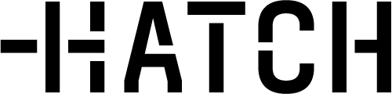
Brokerage
Fees
Foreign Exchange
0.5% Conversion Fee
Trading Fees
0-300 Shares: $3
301+ Shares: $0.01 Per Share

Slide 6



Security Selection
2

Slide 7

Risk Free
ASB Term Deposit
0.15% p.a. (30 day)

Slide 8

Bond ETFs
VGSH
Vanguard Short-Term Treasury Index Fund ETF
VCSH
Vanguard Short-Term Corporate Bond Index Fund ETF
VGIT
Vanguard Intermediate-Term Treasury Index Fund ETF
VCIT
Vanguard Intermediate-Term Corporate Bond Index Fund ETF
VGLT
Vanguard Long-Term Treasury Index Fund ETF
VCLT
Vanguard Long-Term Corporate Bond Index Fund ETF
VMBS
Vanguard Mortgage-Backed Securities Index Fund ETF

Slide 9
Stock ETFs
VTI
Vanguard Total Stock Market Index Fund ETF
VGK
Vanguard European Stock Index Fund ETF
VT
Vanguard Total World Stock Index Fund ETF
VWO
Vanguard Emerging Markets Stock Index Fund ETF
ENZL
iShares MSCI New Zealand ETF
EWA
iShares MSCI Australia ETF

Slide 10
3
Risk Diversification

Slide 11
The Process
1
Calculate Expected Return
Using Historical Returns
2
Calculate Variance And Covariance
Using A Covariance Matrix
3
Alter Portfolio Weights
Using Excel Solver With Constraints
4
Maximise Sharpe Ratio
Using Markowitz Efficient Portfolio Theory

Slide 12
Stock ETFs Covariance Matrix
Weight |  | VTI | VGK | VT | VWO | ENZL | EWA
0.5000 | VTI | 0.0322 | 0.0306 | 0.0302 | 0.0273 | 0.0234 | 0.0339
0.0000 | VGK | 0.0306 | 0.0378 | 0.0315 | 0.0309 | 0.0254 | 0.0364
0.1707 | VT | 0.0302 | 0.0315 | 0.0296 | 0.0292 | 0.0234 | 0.0341
0.0000 | VWO | 0.0273 | 0.0309 | 0.0292 | 0.0393 | 0.0240 | 0.0357
0.3293 | ENZL | 0.0234 | 0.0254 | 0.0234 | 0.0240 | 0.0394 | 0.0328
0.0000 | EWA | 0.0339 | 0.0364 | 0.0341 | 0.0357 | 0.0328 | 0.0525
1.0000 |  | 0.0145 | 0.0000 | 0.0047 | 0.0000 | 0.0094 | 0.0000

Slide 13
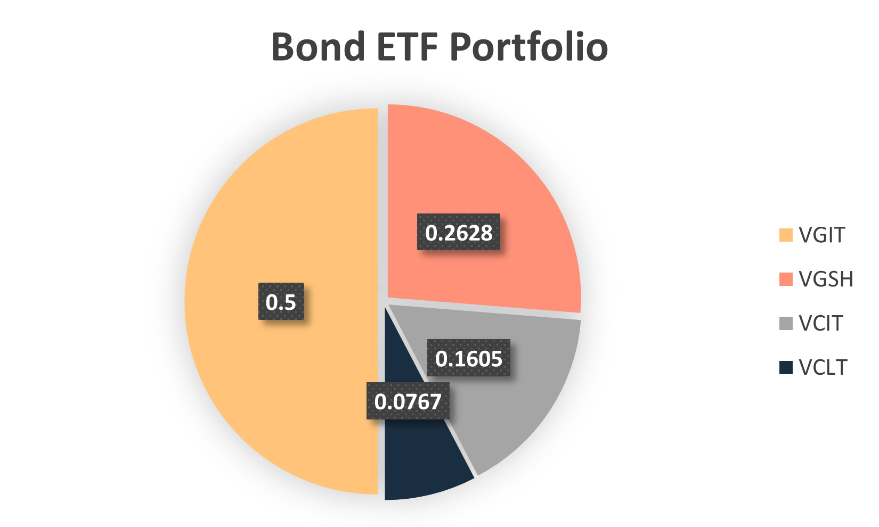
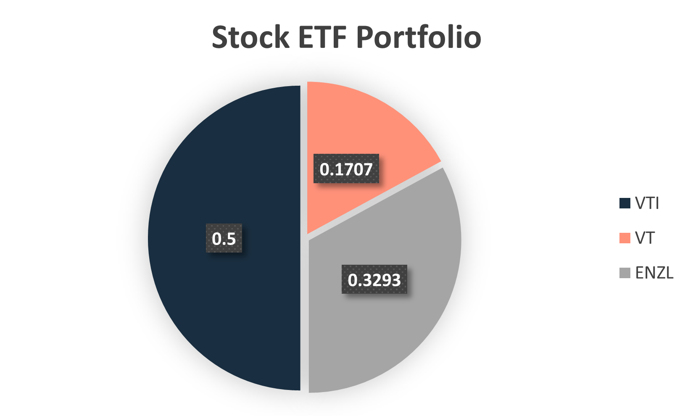
ETF Portfolio Weightings

Slide 14
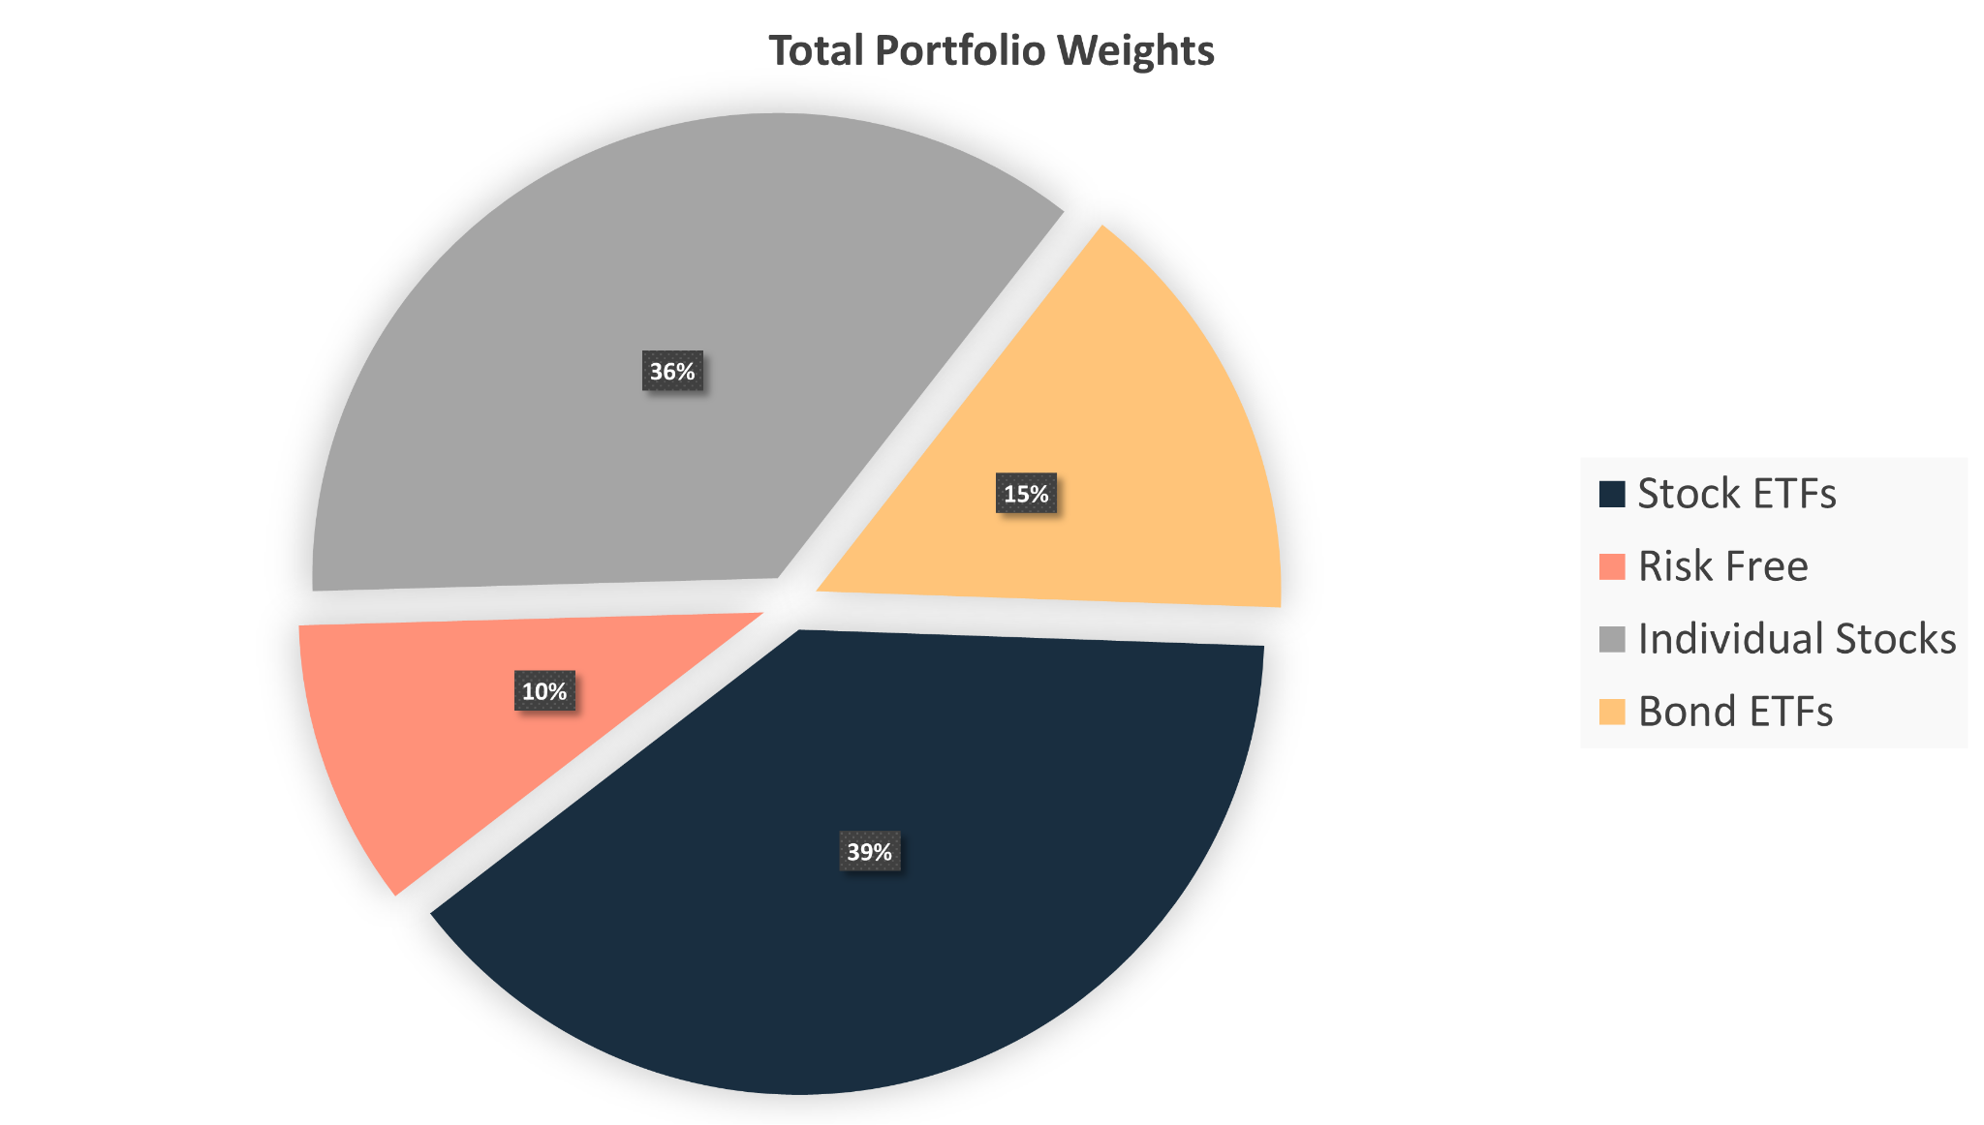
Portfolio Weights

Slide 15
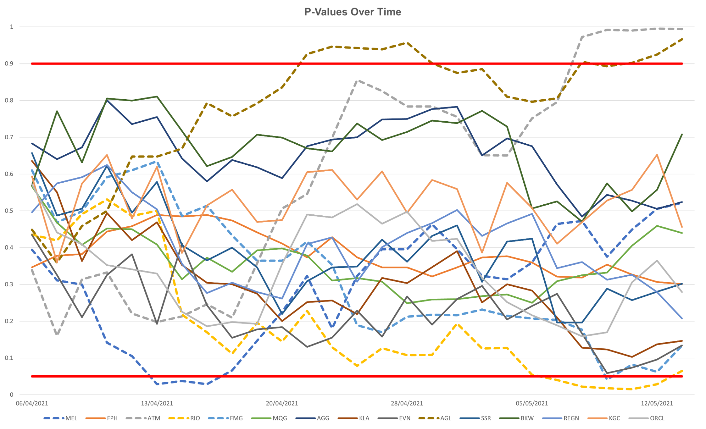
Stock Selection
An Experimental Approach
4

Slide 16
Financials
P/E Ratio
Comparing The Price Of A Stock Relative To A Similar Stock
Price to Book Ratio
A Measure Of A Stock’s Price Relative To Its Underlying Value
Financial Statements
Revenue, Profit, Debt To Equity, Statement Of Cash Flows
52 Week High/Low
Analysing The Stock's Current Price Relative To Its Historical High/Low

Slide 17
Individual Stocks
MEL | Meridian Energy
FPH | Fisher & Paykel
ATM | A2 Milk Company
RIO | Rio Tinto Group
FMG | Fortescue Metals Group
MQG | Macquarie Group
AGG | AngloGold Ashanti Limited
KLA | Kirkland Lake Gold Limited
EVN | Evolution Mining Limited
AGL | AGL Energy Limited
SSR | SSR Mining Inc
BKW | Brickworks Limited
REGN | Regeneron Pharmaceuticals
KGC | Kinross Gold Corporation
ORCL | Oracle Corporation

Slide 18




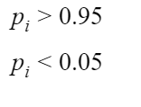
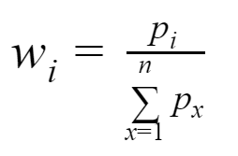
Methodology
Expected Return & P-Value
Selling
Buying

Slide 19
P-Values Over Time

Slide 20

Performance
5

Slide 21
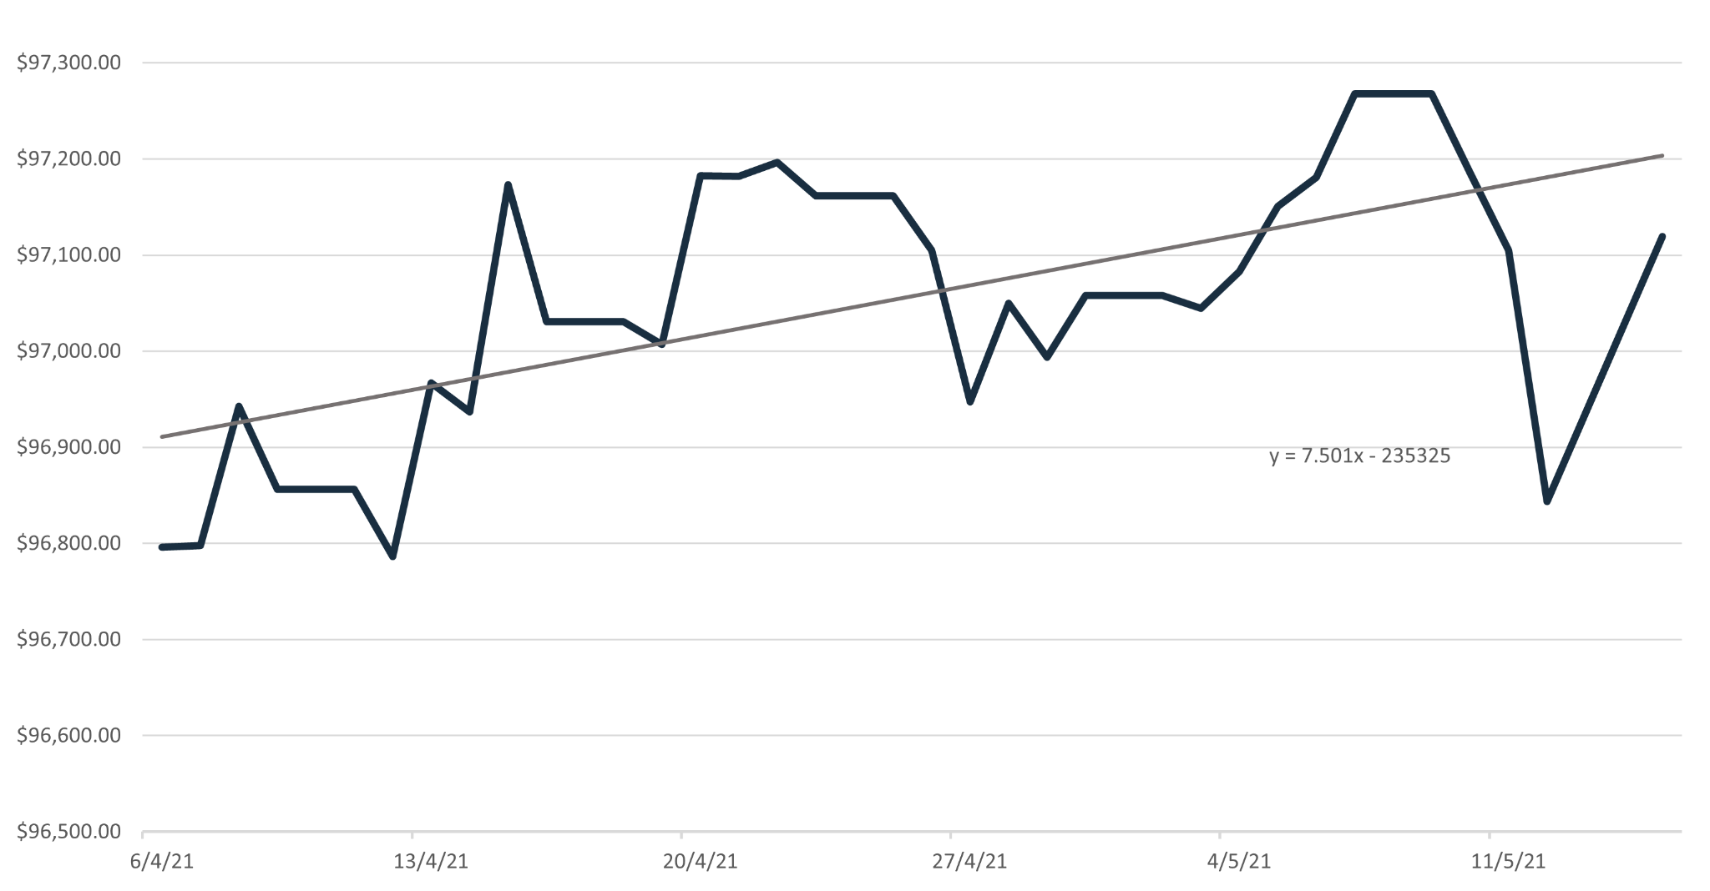
Market Value Over Time: Bond ETFs

Slide 22
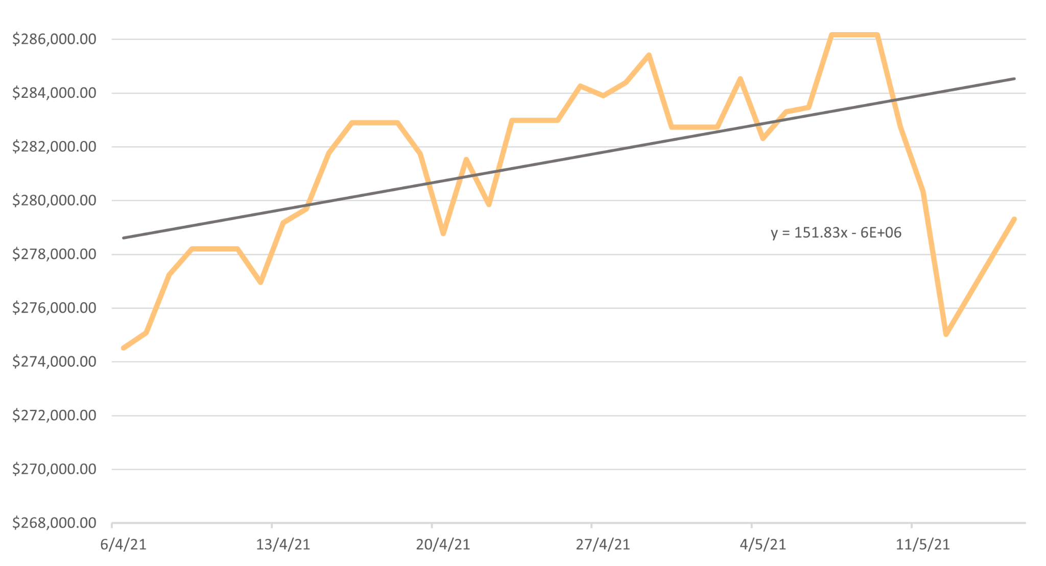
Market Value Over Time: Stock ETFs

Slide 23
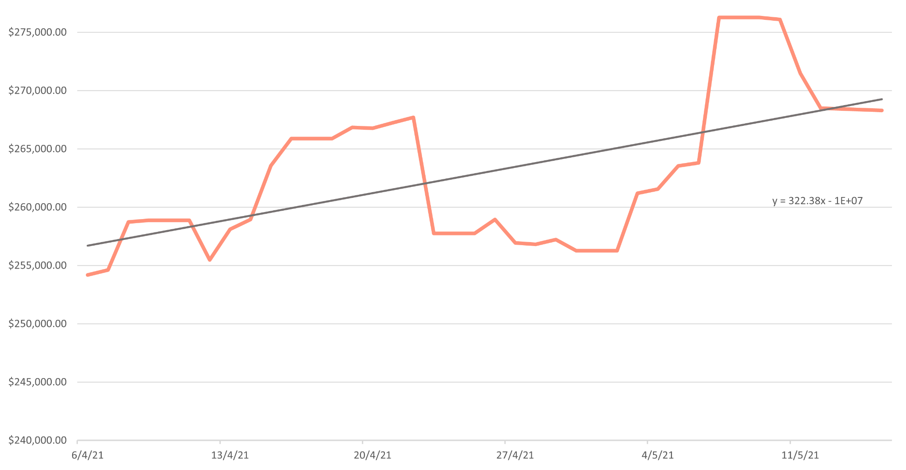
Market Value Over Time: Individual Stocks

Slide 24
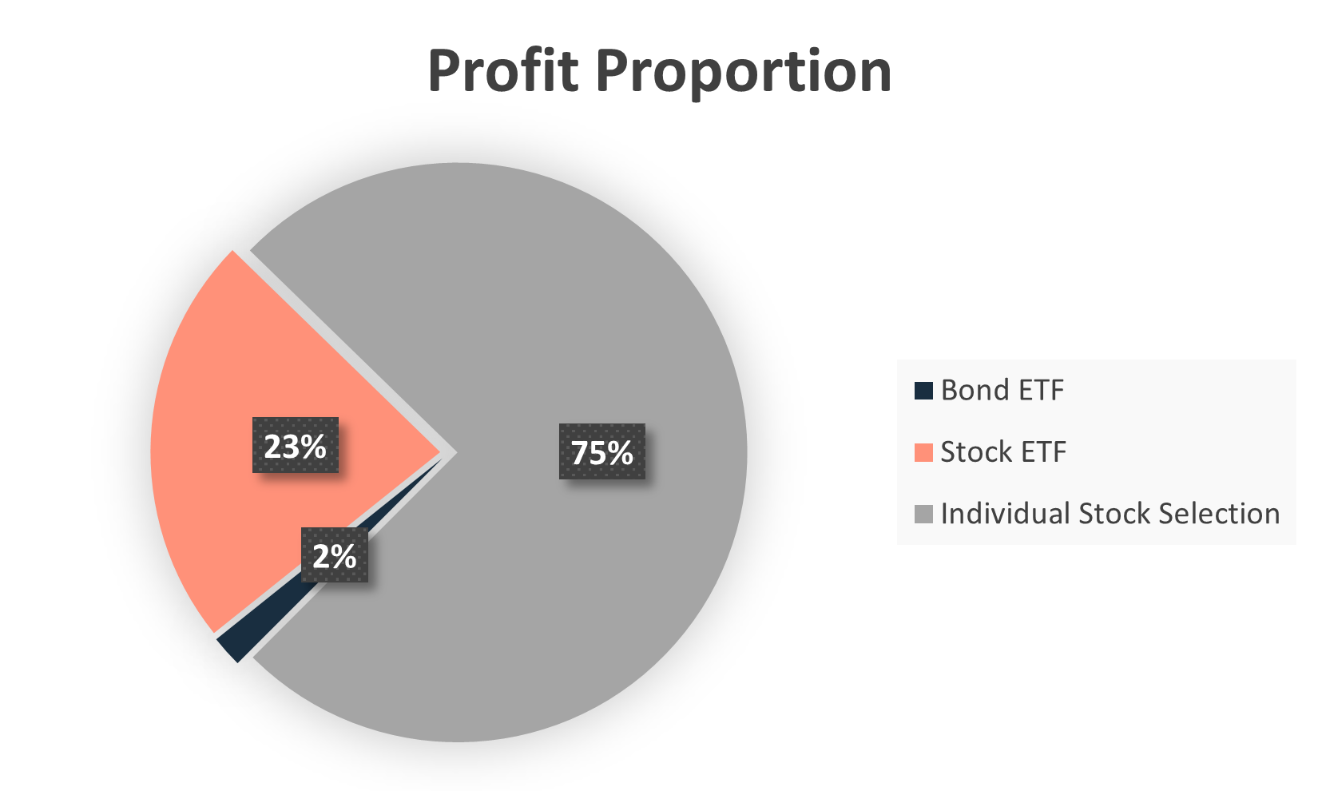
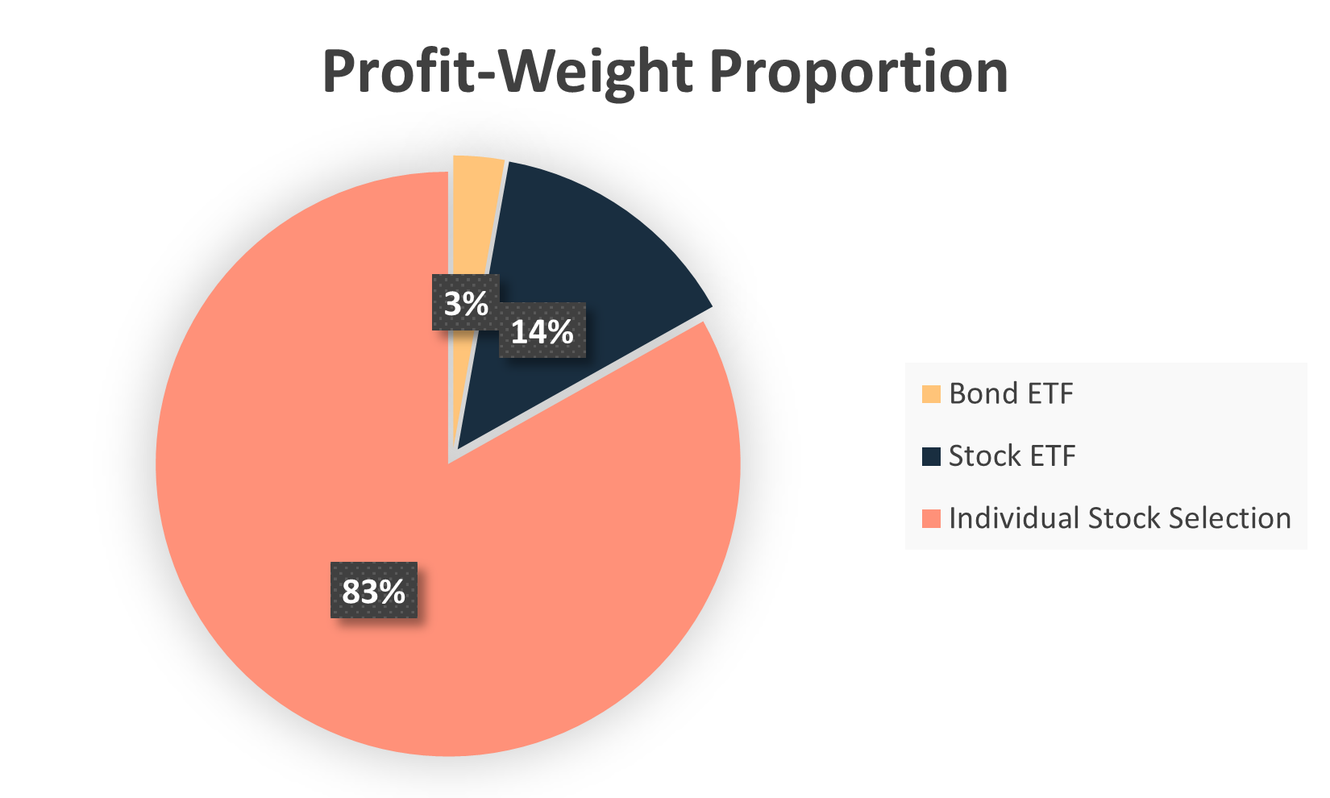
Profit Proportions

Slide 25
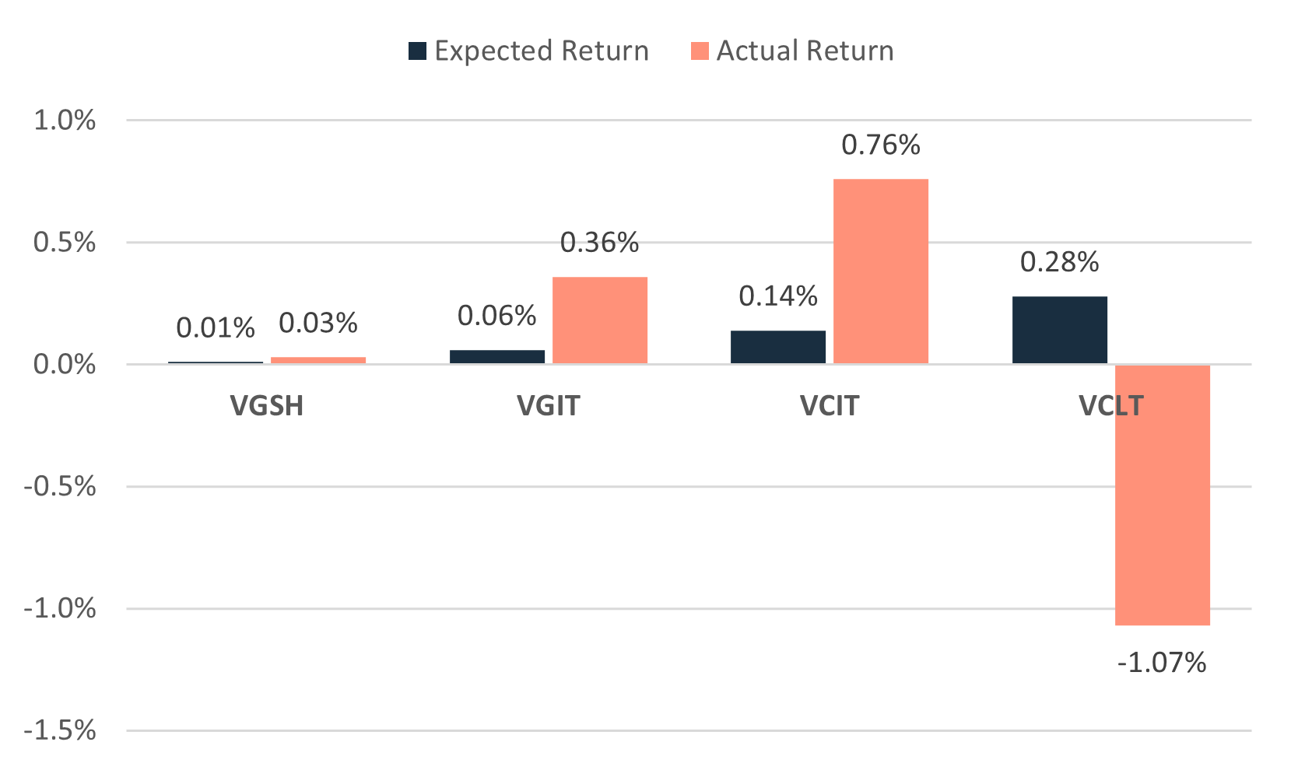
Bond ETFs Expected vs Actual Returns

Slide 26
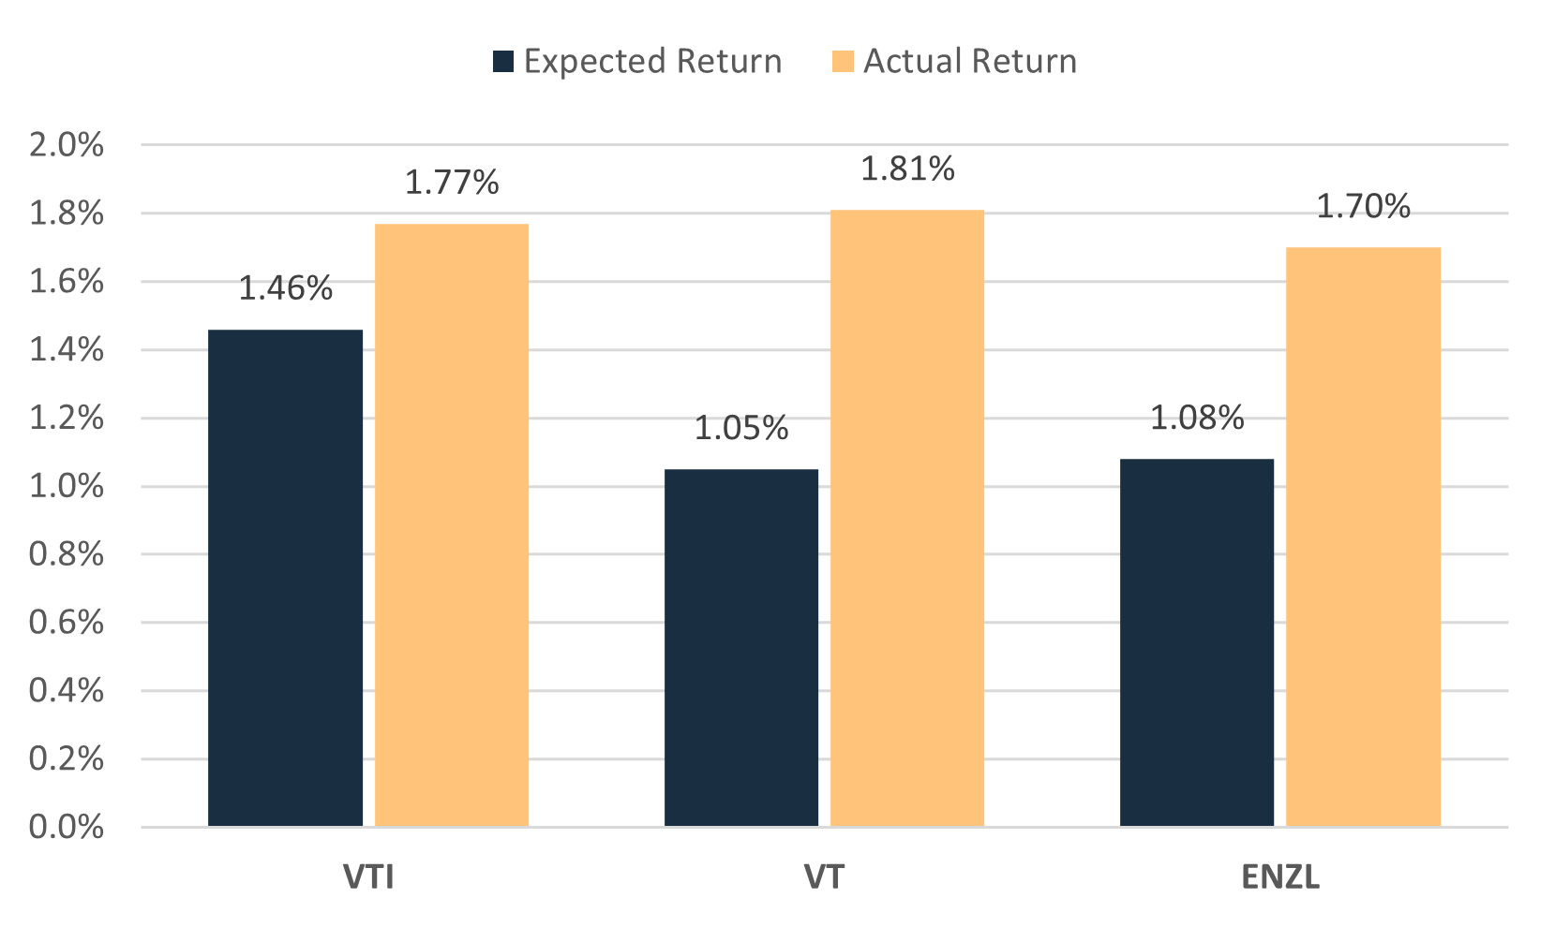
Stock ETFs Expected vs Actual Returns

Slide 27
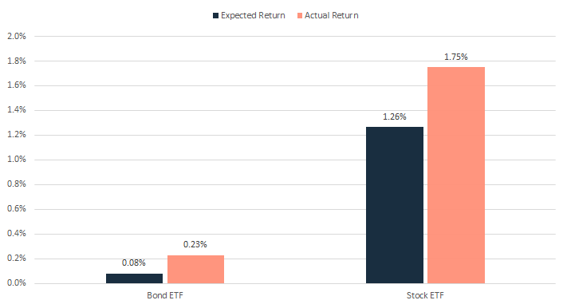
Total ETFs Expected vs Actual Returns

Slide 28
$20,656.88 USD | 3.27%
Key Statistics
$42,146.58 NZD
($8,617.13) NZD | (0.86%)
Risky Asset Return
Foreign Exchange Cost
Net Return of Total Portfolio

Slide 29
Lessons
1
Weights ∝ Profits
How weight impacts returns
5
2
Diversification ≠ Returns
Diversify to maximise return/risk
3
Foreign Exchange Risk
Trading in foreign markets

Slide 30
Thanks

